Slide 1


Investing in Results: TX vs. CA
NGV20
October 22, 2020
Notes:
Give thanks

Slide 2
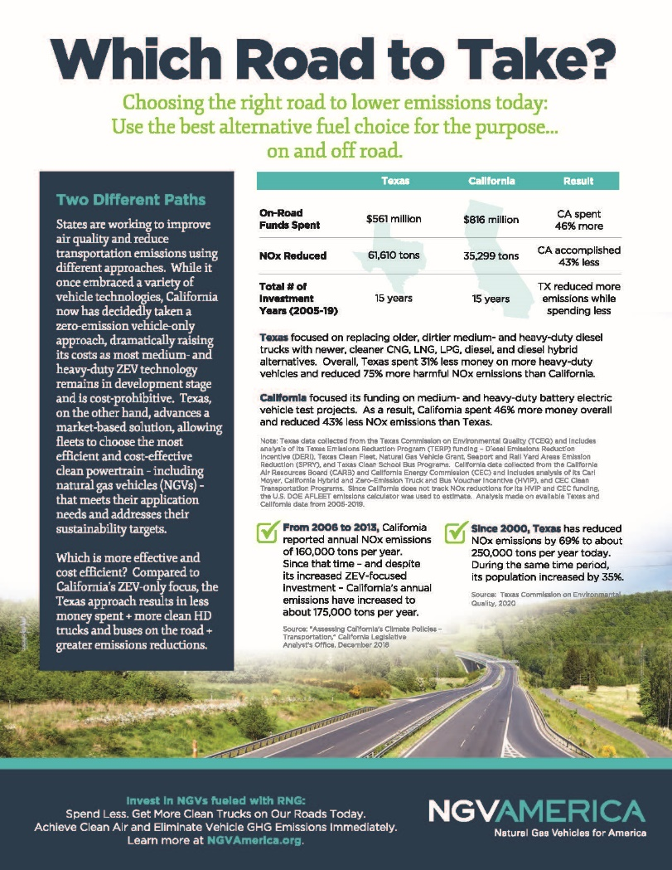

Just released Which Road Flyer
TX vs. CA
Notes:
In 2007, asthma cost the U.S. about $56 billion in medical costs, lost school and work days, and early deaths.
About 1 in 6 (17%) of non-Hispanic black children had asthma in 2009, the highest rate among all racial/ethnic groups.

Slide 3

California has a problem…
From 2006-2013, CA reported annual NOx emissions of 160,000 tons per year. Despite increased ZEV investment, CA’s annual emissions have increased to 175,000 tons per year
Since 2000, TX has reduced NOx emissions by 69% to 250,000 tons per day while population increased by 35%
Sources: CA Legislative Analyst’s Office, 2018
Assessing CA’s Climate Polices – Transportation / TCEQ, 2020

Slide 4

Which Road to Take?
Texas – focused on replacing older, dirtier medium- and heavy-duty diesel trucks with newer, cleaner CNG, LNG, LPG, Diesel and Diesel Hybrid alternatives
California – focused on funding medium- and heavy-duty battery electric vehicle test projects

Slide 5
Medium- & Heavy-Duty Vehicles Funded
Texas: All cleaner fuel technologies allowed

Slide 6
Medium- & Heavy-Duty Vehicles Funded
California: All cleaner fuel technologies allowed in early years,
but funding now narrowed to primarily EV
84% of HVIP $$ to EVs - $337M

Slide 7
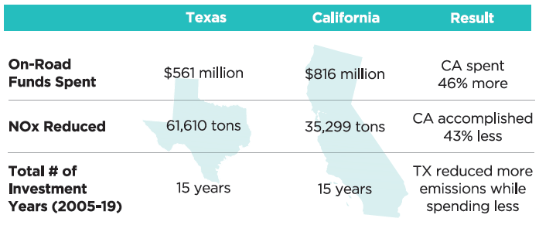
Results: Acceptable for California?
Source: Texas Data collected from the Texas Commission on Environmental Quality (TCEQ) and includes analysis of its Texas Emissions Reduction Program (TERP) funding - Diesel Emissions Reduction Incentive (DERI), Texas Clean Fleet, Natural Gas Vehicle Grant, Seaport and Rail Yard Areas Emission Reduction (SPRY), and Texas Clean School Bus Programs. Analysis made on available Texas and California data from 2005-2019.
Source: California data collected from the California Air Resources Board (CARB) and California Energy Commission (CEC) and includes analysis of its Carl Moyer, California Hybrid and Zero-Emission Truck and Bus Voucher Incentive (HVIP), and CEC Clean Transportation Programs. Since California does not track NOx reductions for its HVIP and CEC funding, the U.S. DOE AFLEET emissions calculator was used to estimate. Analysis made on available California data from 2005-2019.

Slide 8

WHY WAIT for CLEAN AIR?
Notes:
That was a very brief introduction to who we are at NGVAmerica, now I will go into some of the background on vehicle emissions and how natural gas lends itself to be the best solution for powering all VARIETIES of on-road vehicles

Slide 9









Every Medium- & Heavy-Duty and
High Horsepower Application
Long & short haul truck market continues transition
About 30% of transit buses operate on NG
About 60% all new refuse trucks orders are NG
Available Today
Rail industry piloting LNG locomotives
vessels
Ready-Right-Now Technology On and Off the Road Today.

Slide 10
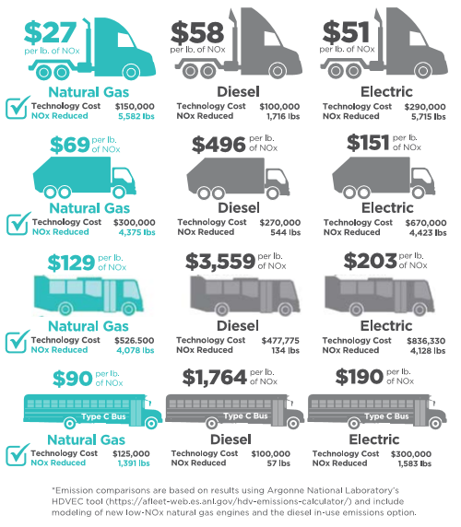

NGVs Deliver the Largest & Most Cost-Effective NOx Emissions Reductions
Across All HD Applications:
  Heavy-Duty Trucks
  Refuse Trucks
  Transit Buses
  School Buses
Cost Effective Today
Source: Emission comparisons are based on results using Argonne National Laboratory’s HDVEC tool (https://afleet-web.es.anl.gov/hdv-emissions-calculator/) and include modeling of new low-NOx natural gas engines and the diesel in-use emissions option.

Slide 11
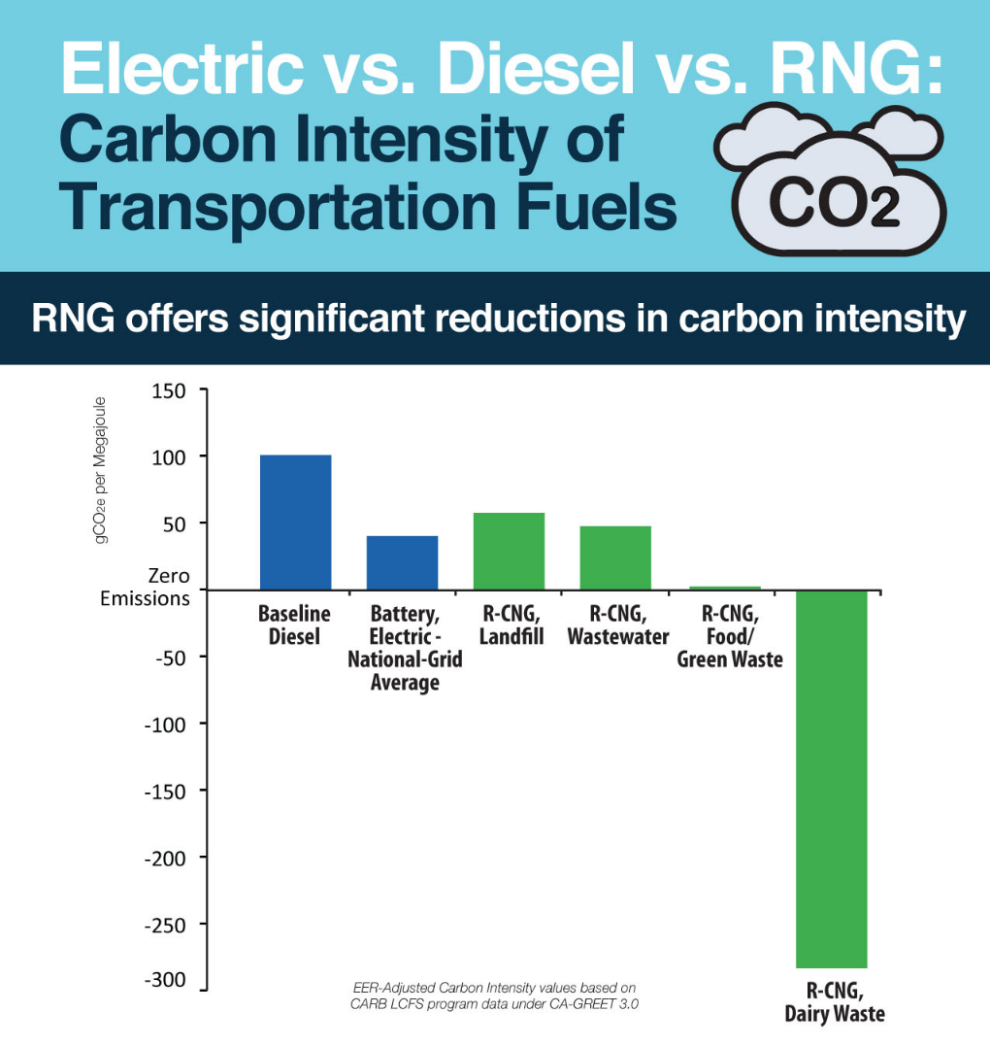

RNG: the most sustainable transportation fuel available today
Reduces Most Emissions Today
Source: EER Carbon-Intensity values based on CARB LCFS program data under CA-GREET 3.0
Notes:
In terms of carbon intensity, RNG is changing the way we think about transportation fuel

Slide 12
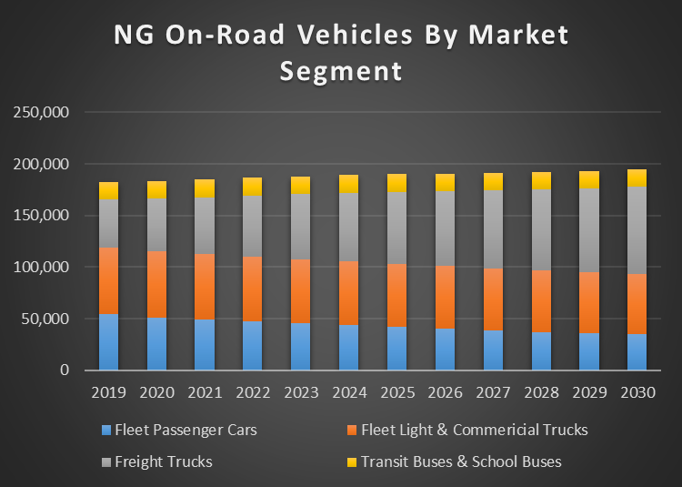
EIA (AEO 2020) Market Forecast of NGVs On-Road
Forecast to Grow
Importance of Freight Trucks
Freight trucks account for greater than 60% of on-road fuel consumption
Freight market size continues to grow in future outpacing other vehicle segments
Sales as reported by EIA for freight trucks are approximately 6,000 units in 2019 but this does not include transit buses. ACT Research estimate for 2019 for Class 7 & 8 trucks was 4,100 trucks and 1,600 transit buses. CWI published data indicates 2019 sales were about 7,900 units.

Slide 13

NET ZERO NOW!
NGVs + RNG offer the cleanest commercially available path to reduce heavy-duty vehicle emissions
Notes:
What does this mean?

Slide 14

Where to Access?
24/7 at NGVAmerica Resource Center at: https://www.ngvamerica.org/resource-center/
NGVAmerica Booth at NGV20’s Virtual Exhibit Hall along with other current NGVAmerica resources and collaterals

Slide 15
Contact Information
Sherrie Merrow – Director, State Government Affairs
smerrow@ngvamerica.org

